Slide 1

Multi-source Brewery Review Database
DSCI 511, Fall 2020
Wynton Britton
Hao Deng
Russell Destremps
Evan Falkowski

Slide 2
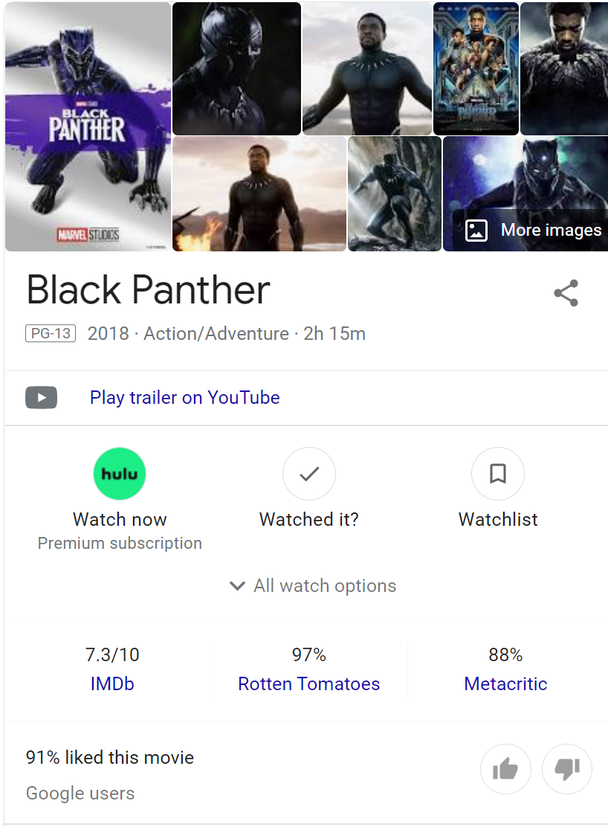
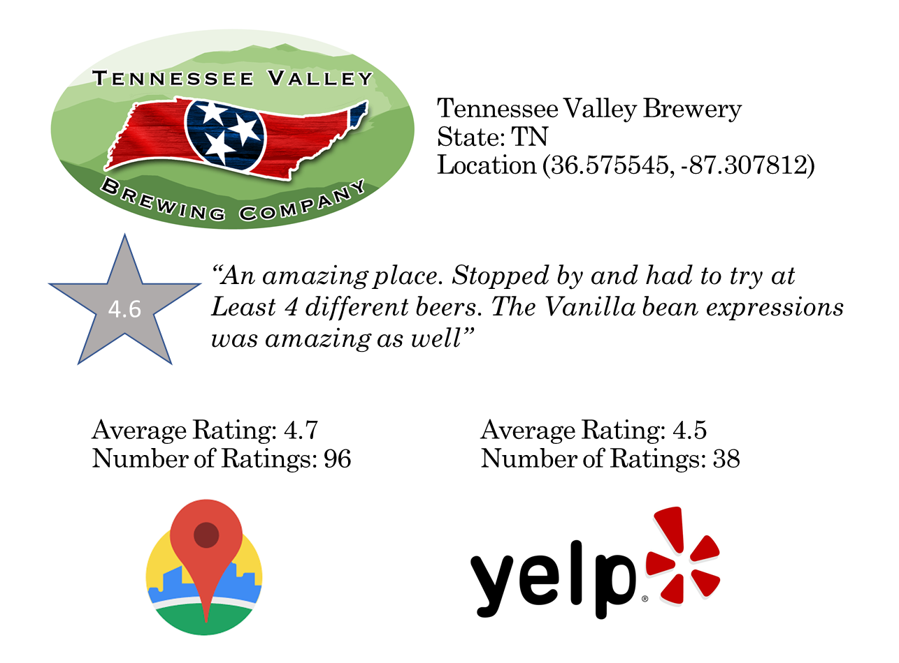
Introduction and Purpose of Dataset
Goal. This dataset seeks to create an authoritative list of craft breweries in the United States, associated location data, and consolidated rating and review data from multiple sources.
Create the brewery equivalent

Slide 3
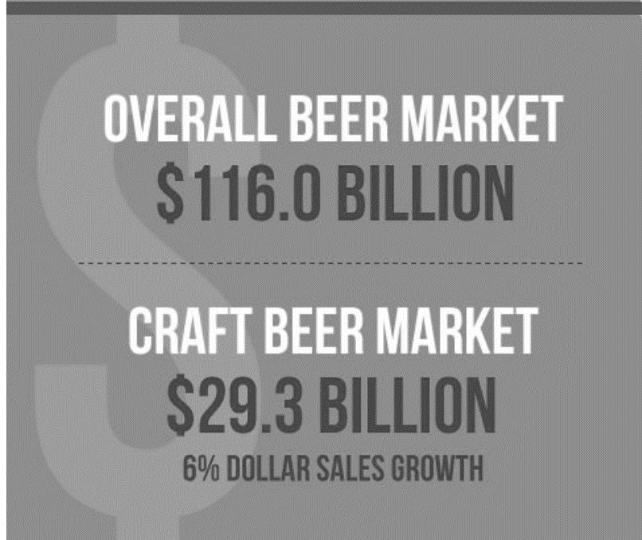
Potential Users and Applications
The use-cases for a multi-source, consolidated review database include, but are not limited to:
Location and rating mapping for interest consumers
Industry benchmarking on brewery ratings in given region(s)
Next level exploration, such as sentiment analysis through natural language processing of reviews
Historical/longitudinal review data could be used for individual brewery, regional, or national industry trend analysis
This information could collectively be used to drive not only consumer choices, but also business decisions for existing or potential brewery owners or interested stakeholders
https://www.brewersassociation.org/statistics-and-data/national-beer-stats/

Slide 4
Source of Data
Data will be derived from two major categories. In each respective case, web-scrapping or API based queries are utilized to deliver desired response.
Master Brewery List Source. In order to ensure more accurate and complete query responses from review sources, the starting point will be an industry based brewery list.
Brewer’s Association: https://www.brewersassociation.org/statistics-and-data/craft-beer-industry-market-segments/
Review and Rating Sources. Initial success limited, in both number of sources and reviews from sources. Despite these mainly commercial ($) limitations, two sources utilized for project and to deliver proof of principle.
Google Places: https://developers.google.com/places/web-service/overview
Yelp Fusion: https://www.yelp.com/developers/documentation/v3

Slide 5
Approach to Acquiring the Data
Master Brewery List
Name and location data
National Brewers Association
Review Sites
Review and rating data
Yelp
Google Places
Database Merge
Standardized and ready for onward analysis
Trip Advisor
Facebook Businesses
Technique: Scraping
Technique: API Requests
Technique: DF Join

Slide 6

Approach to Preprocessing Data
Review and Rating Data.
For each of the review sources, the goal was to develop reproducible, and self-contained cleaning/preprocessing functions that will output data that is current at time of API query as well as prepared for ready merger with other sources.
https://www.payfirma.com/payments-industry/api-101-a-primer/

Slide 7
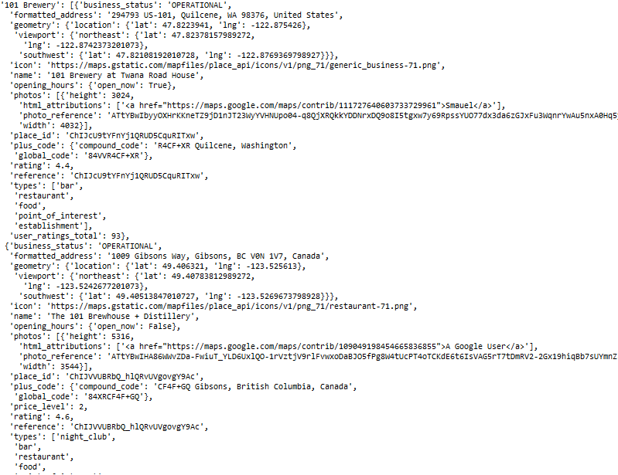
Approach to Preprocessing Data Google Places Example of initial format
Key:
Brewery Name
Resulting tasks:
Filter for accurate responses
Retain only datapoints of interest
First Response for Key
Second, “bad” Response for Key

Slide 8
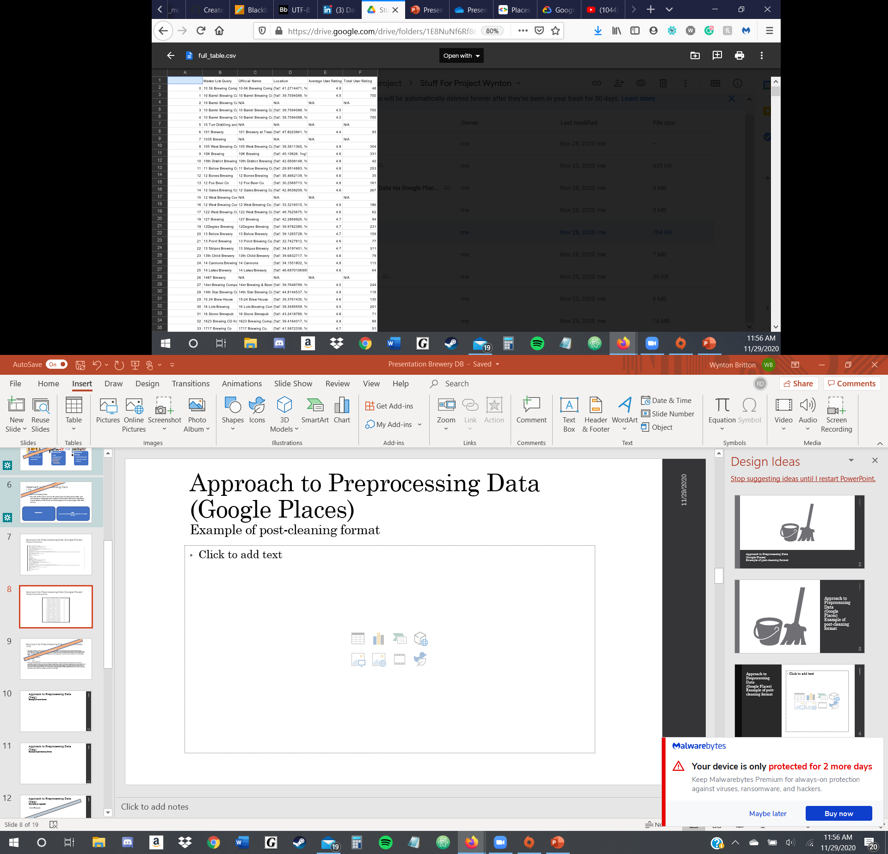
Approach to Preprocessing Data Google Places Example of post-cleaning format
Successfully processed 6,076 of the 7,794 craft breweries in the United States (78%)

Slide 9
Approach to Preprocessing Data Google Places Comments on Approach
Making request and selecting tags to retain. Using the location_name column from the brewery master list compiled from the National Brewers Association as a base, we made requests to the Google Places API. The general structure of the Google Places json data type is html_attributions (empty list), results (list of dictionaries/actual results of the search) and status (OK, ZERO_RESULTS). For the dataset we are trying to form, we are only interested in the following tags:
name
formatted_address
location
rating
user_ratings_total
Filtering the results. Through (very tedious) line by line, brute-force inspection of many of the key-value pairs in the query dictionary (length 7794), we were able to inference that any result list that had a length of one found within the dictionary was almost always an exact match. Furthermore, there are queries that return no data at all. In order to further our investigation and formulate a reproducible strategy, we separated the NULL queries and the queries with exactly one result. This produces roughly 6000 - 6500 separate key-values. Then, we were only left with queries that had multiple results to run through.

Slide 10
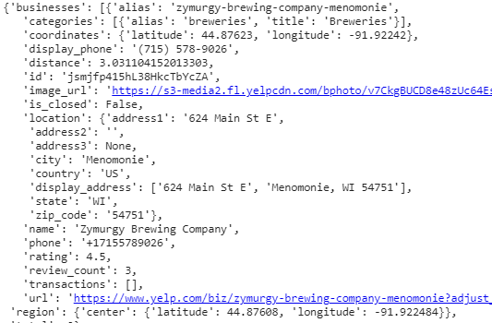
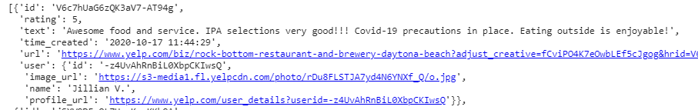
Approach to Preprocessing Data Yelp Example of initial format
Business Response
All breweries from master list looped through response queries:
Obtain yelp business ID and desired associated data
Use yelp business ID to obtain desired review data
Review Response

Slide 11
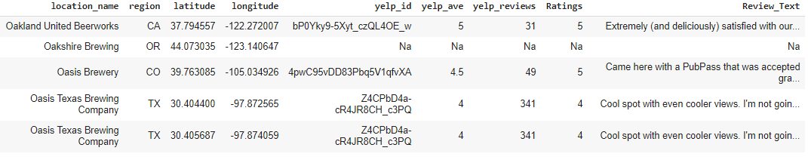
Approach to Preprocessing Data Yelp Example of post-cleaning format
Successfully processed 6,128 of the 7,794 craft breweries in the United States (79%)

Slide 12
Distribution Approach Example Applications.
A single, national database will be end result of individual query, cleaning and merger.

Slide 13
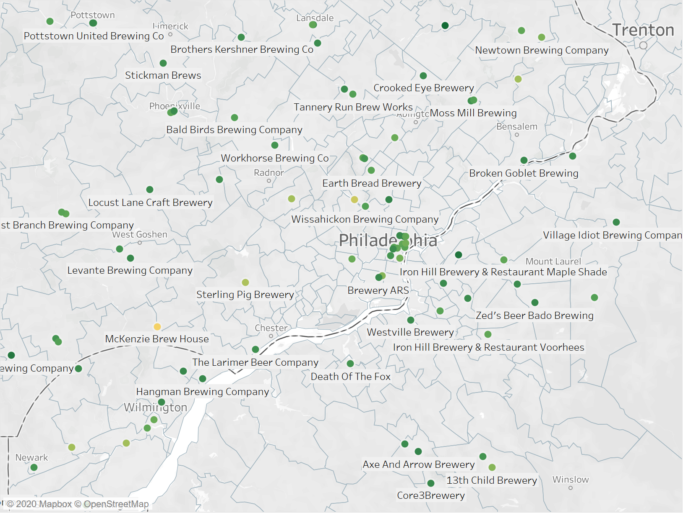
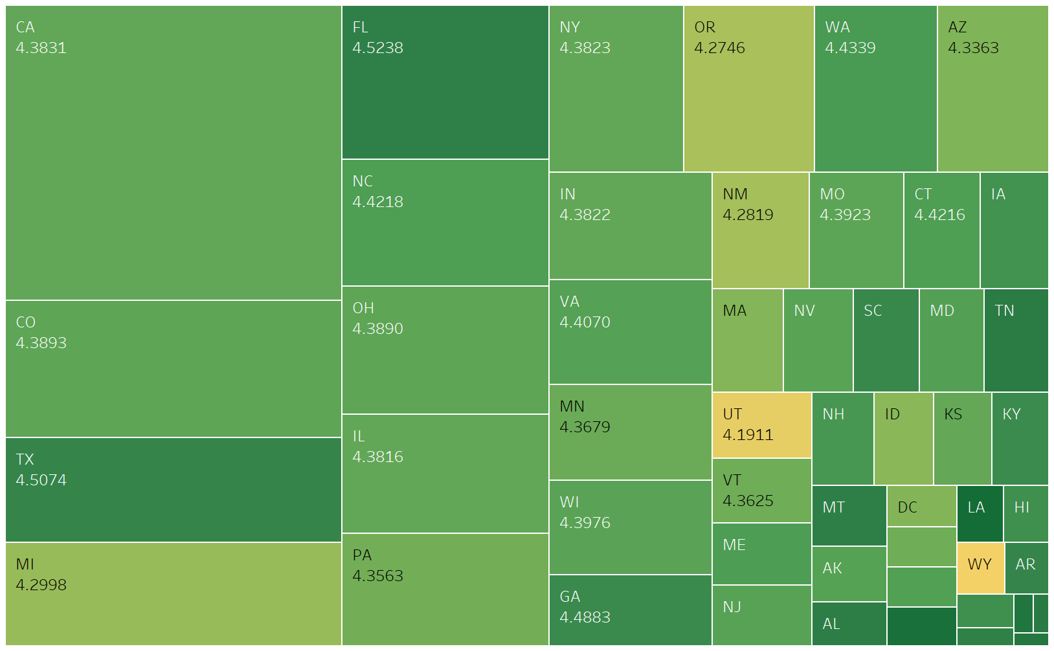
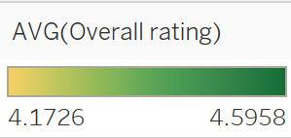
Distribution Approach Example Applications. Geo-referenced heat mapping based on rating.
* Box size represents total relative number of reviews/ratings for state

Slide 14
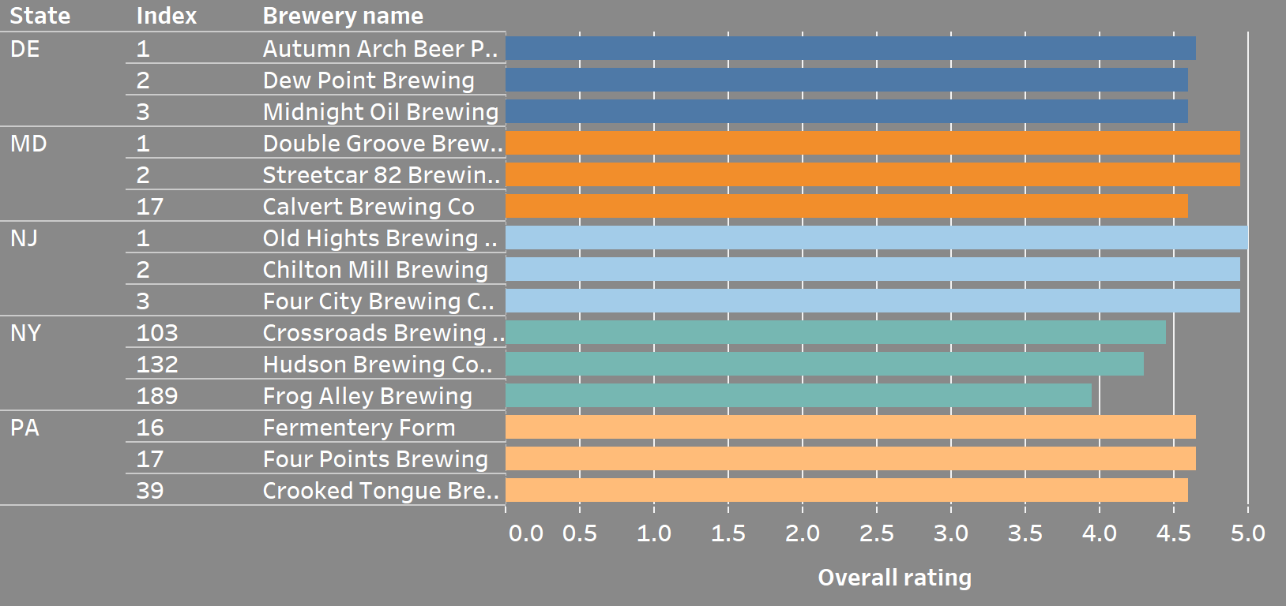
Distribution Approach Example Applications. Location based rating queries
Top 3 Rated Breweries per State*
* Minimum review threshold set at 50. Five states in vicinity of Drexel selected for demonstration

Slide 15
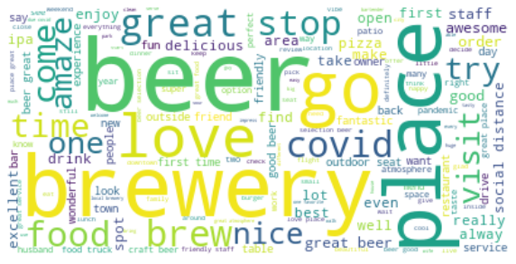
Distribution Approach Example Applications. Language processing and sentiment analysis.

Slide 16
Discussion of Access Rights
National Brewery Association
Official industry data sets are compiled by the Brewers Association for use by their members only.
Google Places
The Terms of Service and Access Rights for Google Places/Google Could are strict and detailed
All in all, this data cannot be publicly distributed unless through Google Cloud application that satisfies the approved use cases. Because this is for academically purposes only, we will avoid this concern.
Yelp
Cannot cache or store any portion for longer than 24 hours
Cannot modify the Yelp Content, or use it to update or create your own database of business listing information,
*Exceptions – for non-commercial use.
Consolidated Database
Must consider retaining access and distribution rights from strictest source, in this case Google Places.
Also, confirmation should be sought from National Brewery Association if their source database for craft breweries could be used for commercial rating consolidation applications.

Slide 17
Challenges, Issues and Limitations
National Brewery Association
A complete database is only available for paid members.
Membership fees would open up continued, up to data access to their master industry database of brewery locations.
The version used for this study is a static, “manually” scraped dataset. Website structure does not lend itself to automated scraping.
Google Places
The Google Places API is very useful in terms of getting specific geolocational data. However, there are some heavy challenges and limitations to weigh before using:
VERY Expensive – charged per 1000 requests.
Trial is a $300 credit, not time based .
Was charged $1500 for running my code constantly, trying to find good query structure.
Search Query format is very broad
https://maps.googleapis.com/maps/api/place/textsearch/json?query=....&key=(API key)
Needed to specify location_name and type of brewery/establishment and still produced zero results for some queries.
Hard to filter through in preprocessing phase – trying to match by name, lat., long., and state proved very difficult.
Some queries would result in places close to the desired place by coordinates and state, but not the actual place.
It also had trouble finding breweries/pubs/restaurants that had multiple locations across the country.

Slide 18
Challenges, Issues and Limitations
Yelp
The Yelp Fusion API is a user friendly tool and Yelp welcomes website/APP developer to use their database. Though there is no entry barrier for Yelp, it is challenging to request the correct response data with limitations:
Limited return on numbers of businesses:
Maximum of 50 businesses will be returned on one Business search call.
Maximum of 1,000 businesses return for one API key.
Maximum of 5,000 calls per 24 hour period.
Consolidated Database
Future use considerations:
If expanded information sought to be retained, a more complex relational database should be developed

Slide 19
Questions?

Slide 20
Team and Contributions
Russell
Presentation development
National Brewery Association master brewery list scraping
Yelp and Google Places troubleshooting
Multi-source review dataset merge
Use case exploration
Hao
Focus on Yelp API data acquisition
Use case exploration and visualization development
Wynton
Acquire trial account for Google Cloud Platform
Compiling data from Google Places API
Creating a dataset of breweries from the Google Places json data
Evan
Focus on Yelp API data acquisition
Yelp focused data wrangling to prepare for joining with other source data

